Slide 1
VISUAL C#.NET session 11
Instructor: Edwin oduor

Slide 2

Quote of the day

Slide 3
Lesson objectives
Methods/Functions
Definition
Types Of Methods
Classes of Methods

Slide 4
Lesson pre-requisites
In order to take full advantage of this section you need to have the following;
Computer with Visual Studio Installed.
Stable Network Connection.

Slide 5
Training methods and extra readings
TRAINING METHODS FOR THIS LESSON
EXTRA READINGS
Lecturing Method – This is the main method of training to be adopted in this lesson with illustrations and practical coding examples.
Discussion Method - This method will be adopted periodically whereby learning will be derived principally from the students brainstorming together, rather than from the trainer. Three main types of discussions will be used:
Directed discussion
Developmental discussion
Problem-Solving discussion
Home and Learn C#

Slide 6
Methods/functions

Slide 7
WHAT is A method or a function?

Slide 8
The term Functions and methods are usually used interchangeably, when talking about methods and Functions then we are basically talking about the same thing. Methods are a bunch of code that is performing a certain task, when one wants to use, one does not need to write the code again, what one does is to call the function created. Methods makes it possible to follow the principle DRY (Don’t Repeat Yourself). Once a function has been written, to use it you just call it. Below is the structure of a method.
public void printFullname(){
// body of the function
}

Slide 9
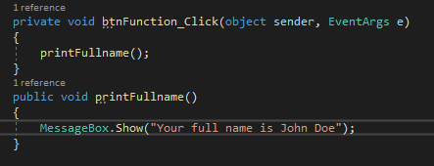
In the code below we have created a function called printFullname, what the function does is to print the message your full name is John Doe. You will notice that printFullname is being called inside the button btnFunction.
From code on the left suppose we want to call the function and when calling also provide the first and last name so that it’s printed in the message box, then we will modify our function so that it can accept parameters in the brackets

Slide 10
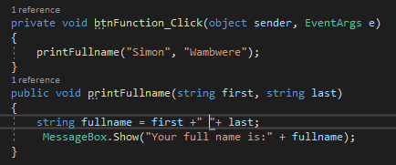
Now after modification our function is going to look like this.

Slide 11
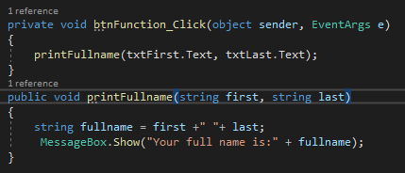
Let’s now modify the above function so that we get the first and last name from the textbox, after modification then this is what we get.

Slide 12
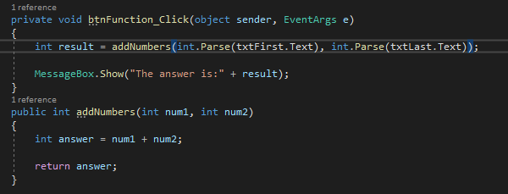
Still continuing with the function, let’s create another function that is going to add numbers together and give us the answer. For this function we will add two numbers together after adding the numbers the function is going to return to us the answer. We have a variable that is going to hold the answer and return for us the answer using the return key word.

Slide 13
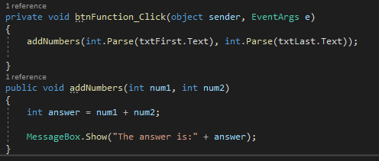
We can still achieve the same as shown in the previous code but without using the return key word. In the below code we have achieved the same results but without using the return key word. Kindly check out the code in the previous slide and this slide and note the difference.

Slide 14
From the above examples we can now say that we have different classes of functions/methods 1. Method that one does not need to provide anything in the brackets,
2. The second one has to enter some parameters in the bracket
3. The third one is whereby we are using the return key word.

Slide 15
Types of methods

Slide 16
Instance method
Instance method are methods that require an object of the class to be created, once it has been created one can use the object created to use the method.

Slide 17
static method
Static method on the other hand is a method that can be called directly without creating an object.
NB: Kindly note we will revisit the above concept about different types of methods once we have talked about Classes and objects, once we have learnt about classes and objects then this is going to be clearer and we will be able to create the types of methods mentioned. We will also talk about method overloading and method overriding later after talking about classes and objects.

Slide 18
exercise

Slide 19
Create a method called FizzBuzz, when a number entered in a text box that is divisible by three it should print Fizz, if the number entered is divisible by Five should print Buzz, if the number entered is both divisible by three and five then it should print FizzBuzz.

